Slide 1




STACK OVERFLOW
DEVELOPER SURVEY 2019
Muhammad Daffa Hilmy
5 November 2023

Slide 2

OUTLINE
Executive Summary
Introduction
Methodology
Results
Visualization – Charts
Dashboard
Discussion
Findings & Implications
Conclusion
Appendix

Slide 3

EXECUTIVE SUMMARY
This presentation summarizes key findings from the 2019 Stack Overflow Developer Survey, focusing on a subset of survey data covering data technologies and demographic information. The goal was to identify present and future data technology trends among people of different age groups worldwide.
Existing technology trends were characterized by JavaScript as the leading programming language, MySQL as the primary database system, Linux as the preferred operating platform, and jQuery as a popular web framework. Future technology interests included learning JavaScript, PostgreSQL, Linux, and React.js.
Survey respondents were predominantly male, with bachelor's or master's degrees, aged between 21 and 43, and primarily located in the United States. The analysis highlighted a strong developer interest in JavaScript and web development languages and a notable increase in enthusiasm for NoSQL databases, particularly MongoDB and Redis.

Slide 4

INTRODUCTION
This report is centered around the process of gathering data from diverse sources and discerning the prevalent technology trends for this year's report on emerging skills. Its intended audience comprises a wide spectrum, including current and future developers, leaders in the IT industry, students pursuing computer science, HR professionals, and educators.
The report provides valuable insights in three key areas. Firstly, it aids in identifying the existing technology trends within the market, giving readers an up-to-date understanding of the technology landscape. Secondly, it offers foresight into the technologies that are likely to gain prominence in the future, helping readers anticipate the shifts in technology usage. Lastly, the report facilitates HR professionals in targeting potential employees by leveraging the demographic information and profiles presented in the report, aiding in strategic recruitment and talent acquisition efforts.

Slide 5

METHODOLOGY
Data Collection: The data utilized in this report originates from three distinct sources, comprising a subset of the Stack Overflow Developer Survey 2019, job postings obtained through the Jobs API, and annual average salaries for programming languages collected via webscraping.
Data Wrangling: To ensure data quality and consistency, the subset data from these sources underwent a data wrangling process. This involved the removal of missing values, deduplication, and the normalization of data, rendering it more suitable for analysis.
Exploratory Data Analysis: Following the data cleaning stage, exploratory data analysis was conducted to delve into the dataset's characteristics. This entailed the identification of outliers, an examination of data distributions, and the exploration of correlations between various columns.
Data Visualization: The presentation of the subset data from the survey was made more accessible and informative through the creation of a dashboard using IBM Cognos. This visualization tool was used to convey insights and trends effectively, facilitating a clearer understanding of the data's implications.

Slide 6

RESULTS

Slide 7
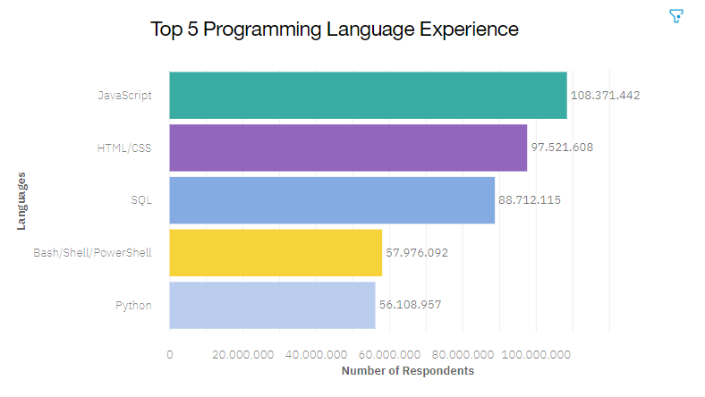
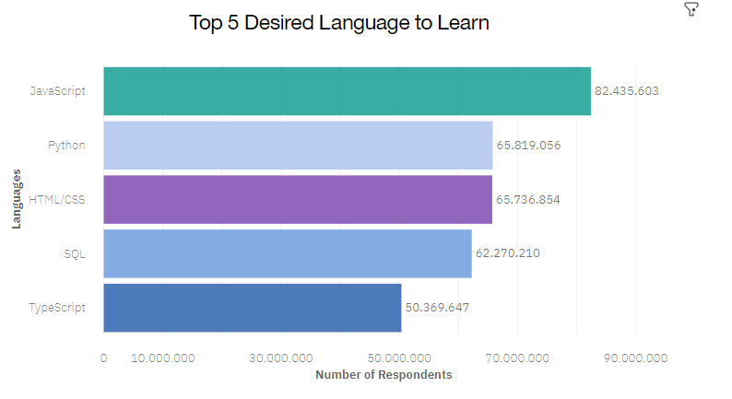
PROGRAMMING LANGUAGE TRENDS
Current Year Next Year

Slide 8
PROGRAMMING LANGUAGE TRENDS - FINDINGS & IMPLICATIONS
Findings Implications
JavaScript and HTML/CSS are the popular languages among developers and will remain in future as well.
There is an increased interest in developers to learn python and TypeScript next year.
SQL is an important language among developers and will likely remain next year as well.
Bash/Shell/PowerShell has seen a decrease in interest for next year.
Web development jobs will continue to remain in high demand in the future as there is an increased interest in TypeScript as well along with JavaScript and HTML/CSS
SQL will remain the preferred language for big data storage and querying.
Python is useful in AI and machine learning, and an increased interest will help create more job opportunities.

Slide 9
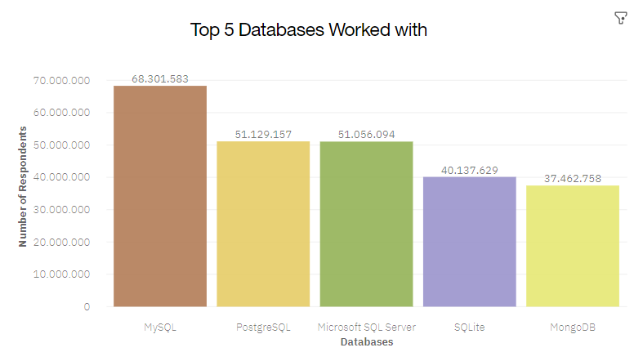
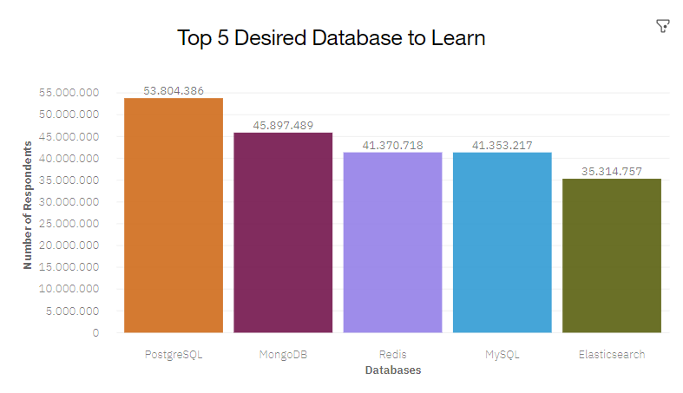
DATABASE TRENDS
Current Year
Next Year

Slide 10
DATABASE TRENDS - FINDINGS & IMPLICATIONS
Findings Implications
SQL database programs were the most popular in 2019, with MySQL in lead and followed by Microsoft SQL Server.
But, for next year PostgreSQL has gained a lot of popularity as compared to all SQL databases.
There is a tremendous interest in MongoDB and Redis among developers.
Elasticsearch has also gained a lot of interest in developers to learn.
Due to PostgreSQL ability to smoothly tackle voluminous databases and complex queries it has gained interest among developers.
With increased usage of social media, NoSQL database is also gaining popularity as data cannot always be stored in a table to query.
Current developers need to learn NoSQL database with relational database to keep up with the trend.
Aspiring developers need to focus both on relational database as well as non-relational.

Slide 11
DASHBOARD
https://jp-tok.dataplatform.cloud.ibm.com/dashboards/695fbbf8-96ee-452a-9833-a2b20b8b0a98/view/5425a535058d6fd16fcdb5e4079079047c3e775bb2bb870587d07b490e337497f33d1a91c87c485bda47536aa5ef1a58c8

Slide 12
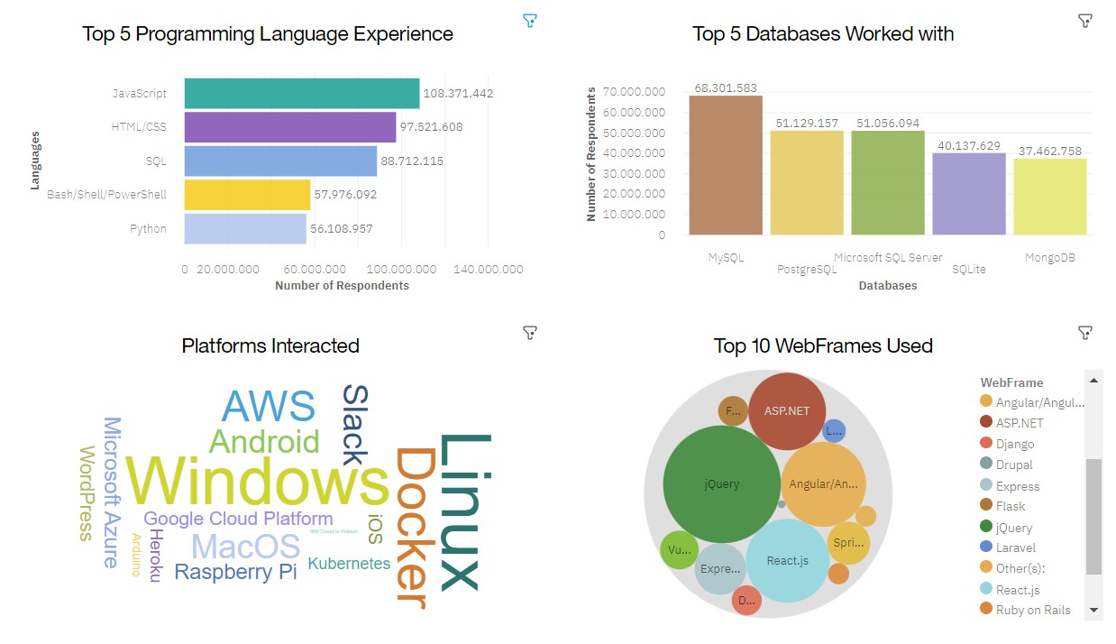
CURRENT TECHNOLOGY USAGE

Slide 13
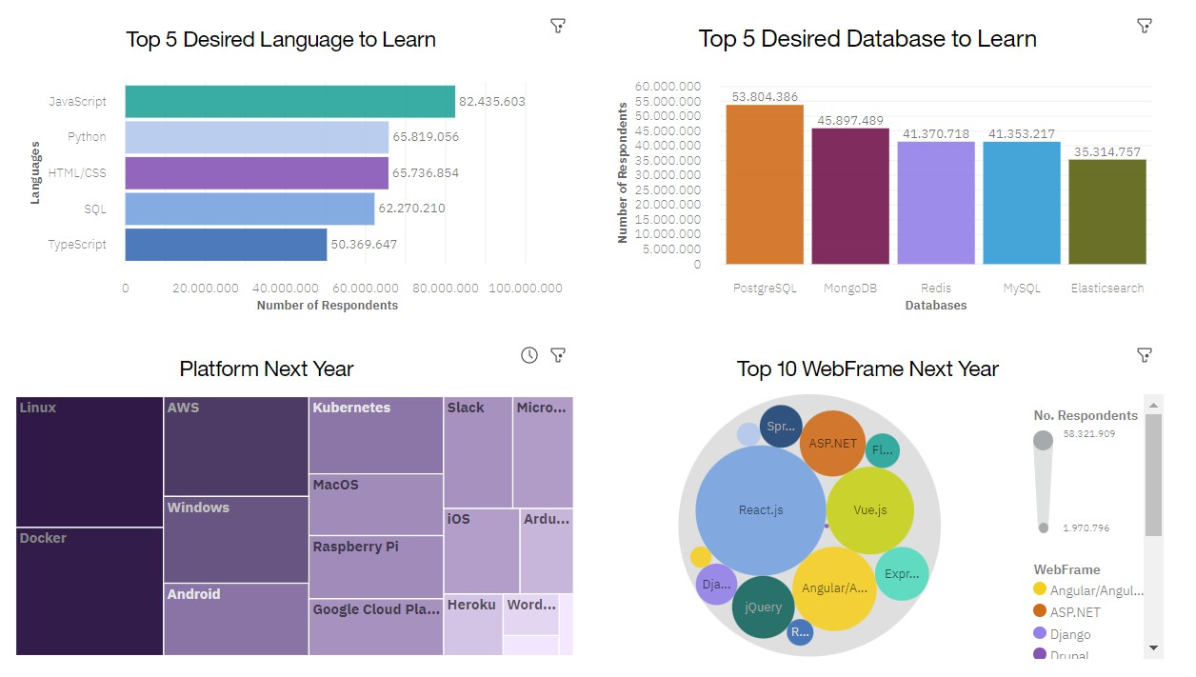
FUTURE TECHNOLOGY TREND

Slide 14
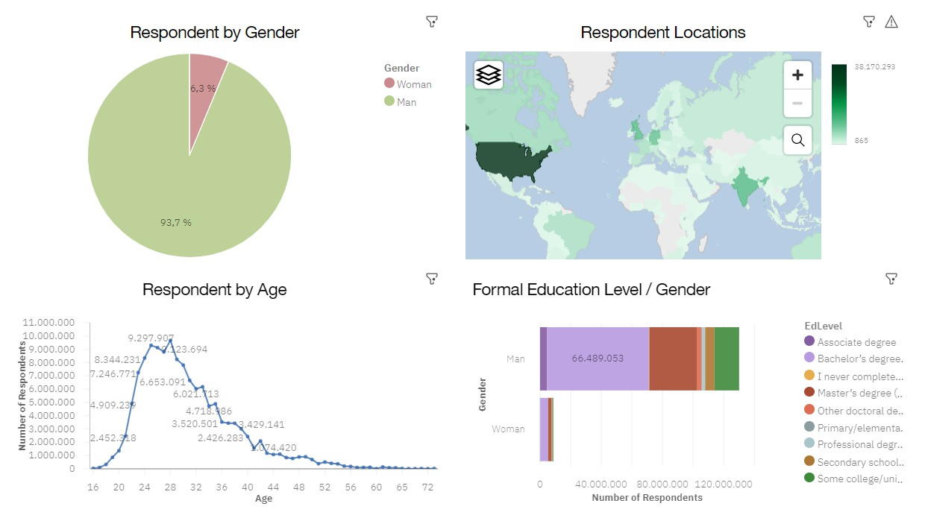
DEMOGRAPHICS

Slide 15
DISCUSSION

Slide 16
OVERALL FINDINGS & IMPLICATIONS
Findings Implications
JavaScript and HTML/CSS remain popular and will continue to be so, with growing interest in Typescript.
SQL and Python were most used in 2019 and remain the top choices for developers in the upcoming year.
MySQL led in 2019, but developers are increasingly interested in PostgreSQL, while NoSQL databases are gaining traction.
Linux remains the primary platform and is expected to maintain its dominance into the next year.
Pronounced age and gender discrimination is evident within the IT industry.
Prospective web developers have bright career prospects due to the popularity and high job demand for web development languages.
Data professionals need competence in both SQL and NoSQL databases, along with Python expertise to stay competitive.
Data experts should be adept at handling various platforms, with Linux being the most prevalent.
Industry leaders and HR professionals can contribute to eliminating gender discrimination in the workplace.

Slide 17

CONCLUSION
The aim of this report has been successful in identifying emerging technology trends for both 2019 and the upcoming year.
This report offers valuable insights to businesses for staying updated with emerging trends, helps learners determine which technologies to prioritize, and guides educators in developing relevant content according to current trends.
Businesses can adapt their workforce by recognizing skills no longer in demand and facilitating employee upskilling in emerging areas.
Businesses and industries should actively work towards diminishing gender disparities.

Slide 18

APPENDIX

Slide 19
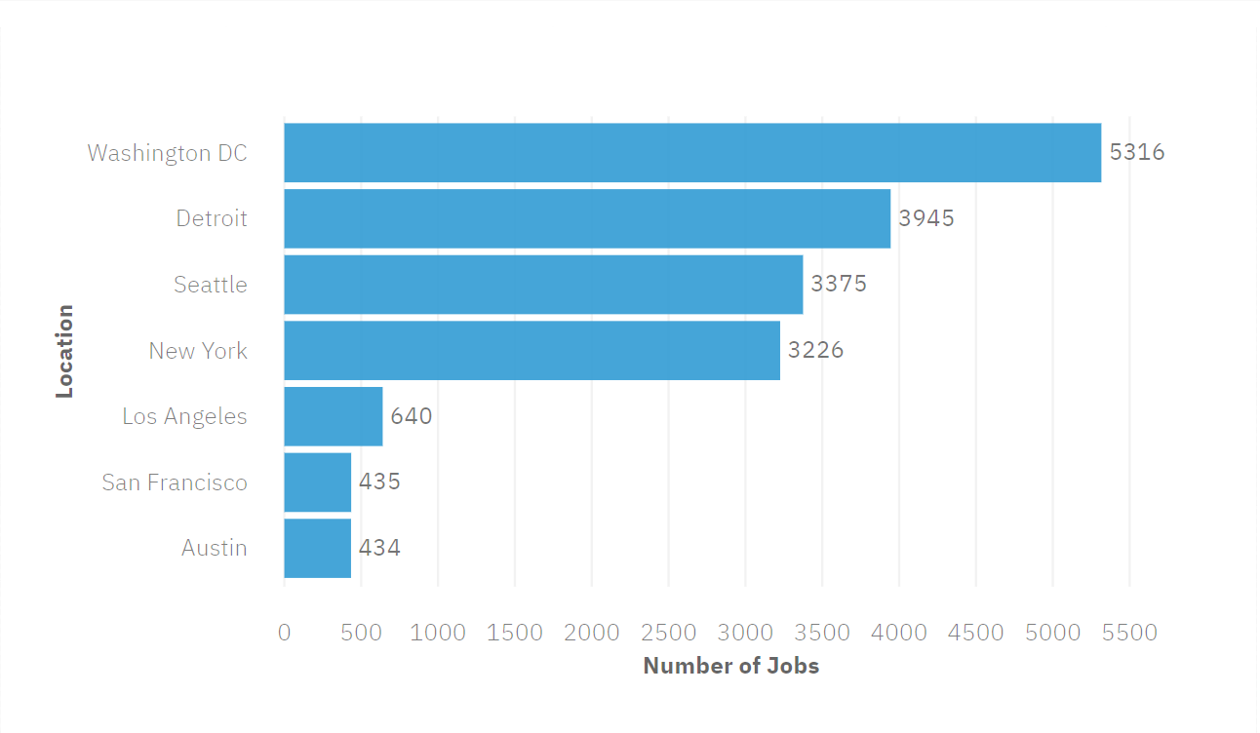
JOB POSTINGS

Slide 20
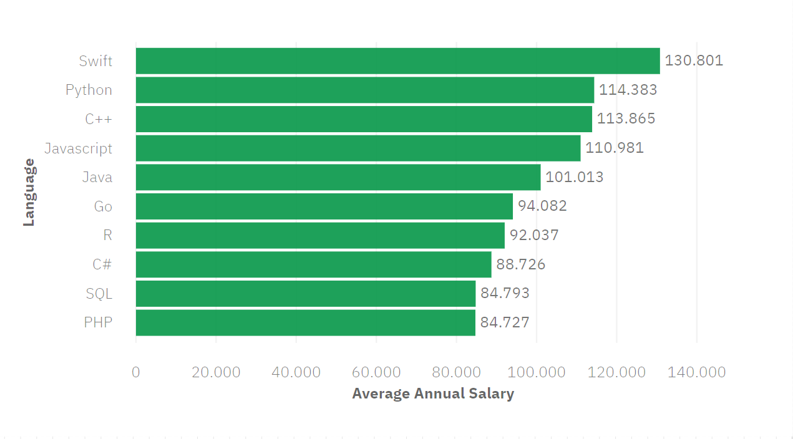
POPULAR LANGUAGES

